Slide 1
CGRS Dashboard

Slide 2
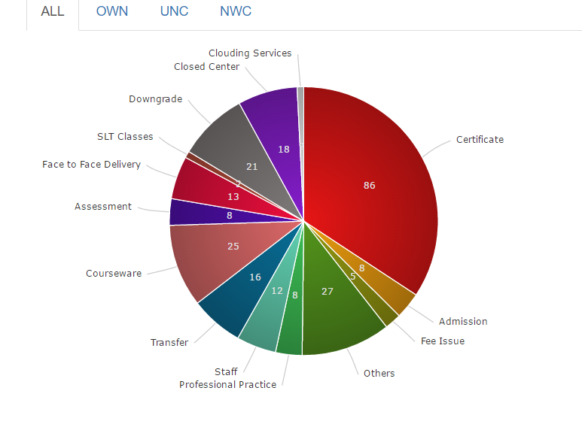
Pie Charts
1). Tabs to Click on Various Centres
2). The various slices Information

Slide 3
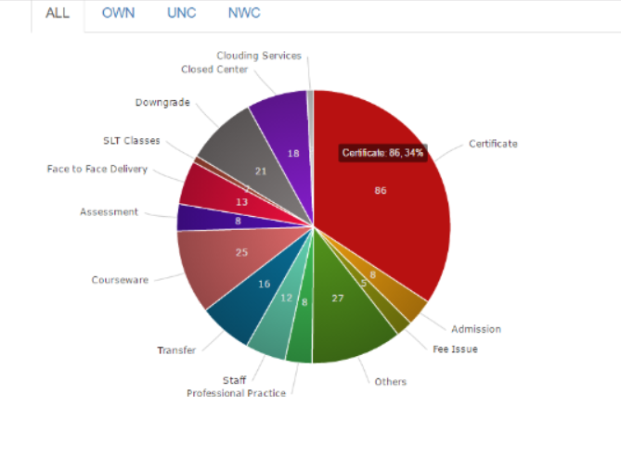
Tooltip
Tooltip lightens that Division and shows it’s name as well as it’s percentage in the Pie chart

Slide 4
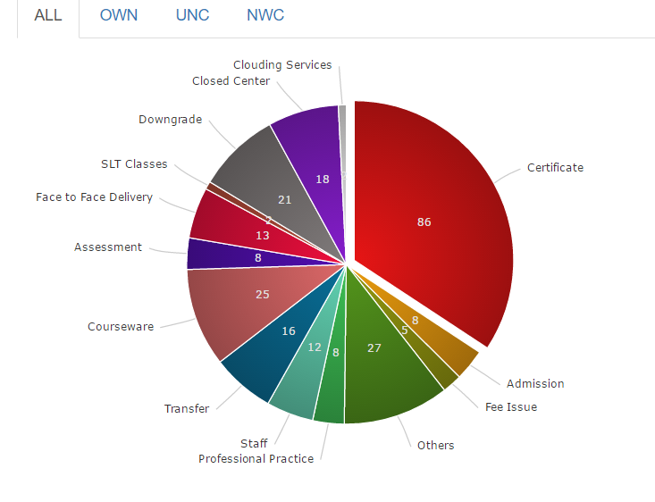
When a Slice is clicked
When a portion is clicked , that particular slice slides out.

Slide 5
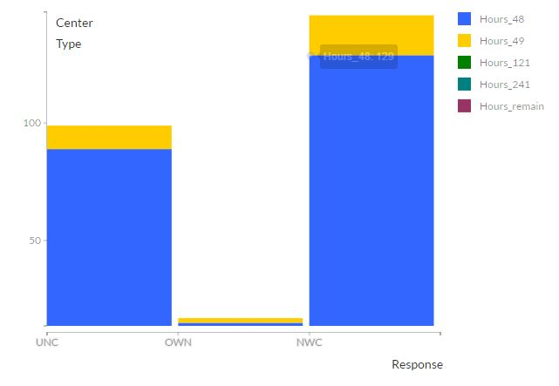
Center Type Wise Response SLA -48 Hrs

Slide 6
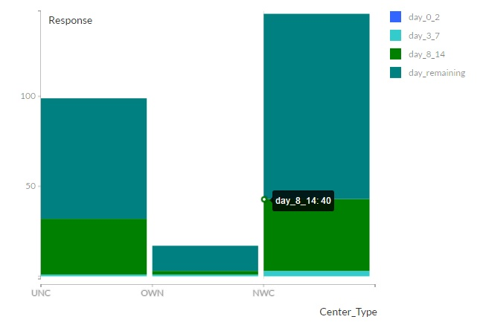
Center Type Wise Resolution SLA- 14 Days

Slide 7
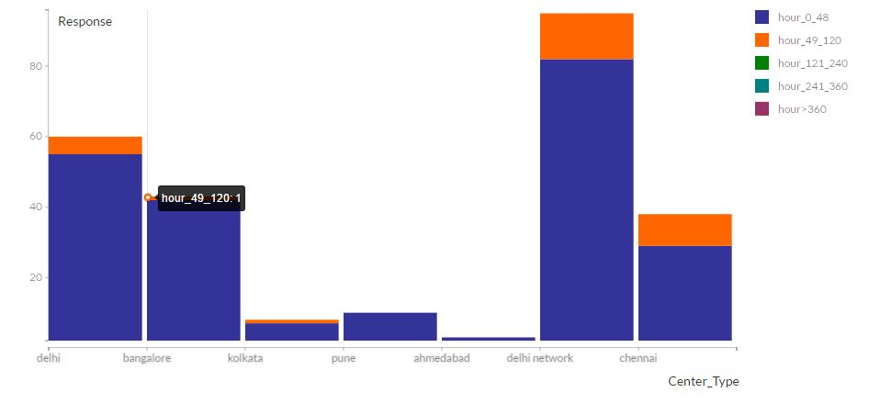
Region Wise Response SLA -48 Hrs - ALL

Slide 8
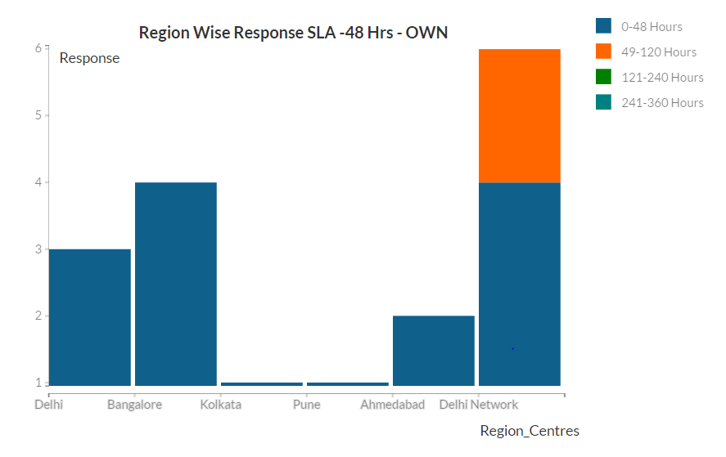
Region Wise Response SLA -48 Hrs - OWN

Slide 9
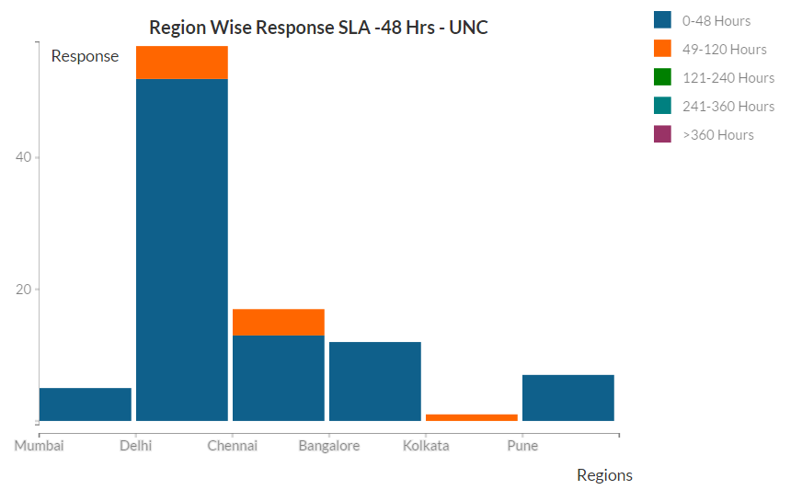
Region Wise Response SLA -48 Hrs - UNC

Slide 10
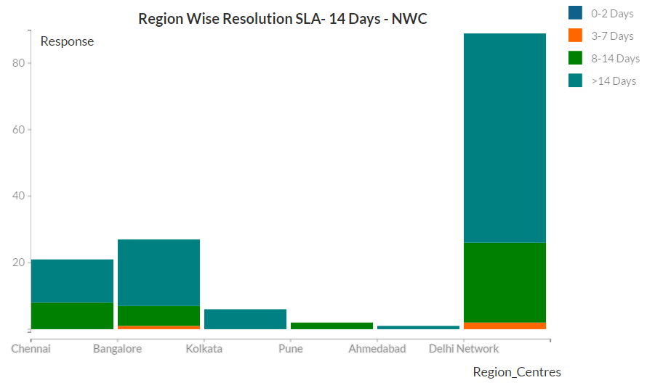
Region Wise Response SLA -48 Hrs - NWC

Slide 11
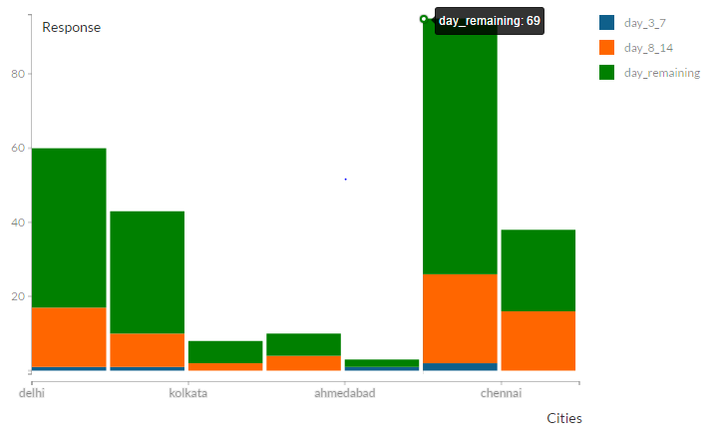
Region Wise Resolution SLA- 14 Days - ALL

Slide 12
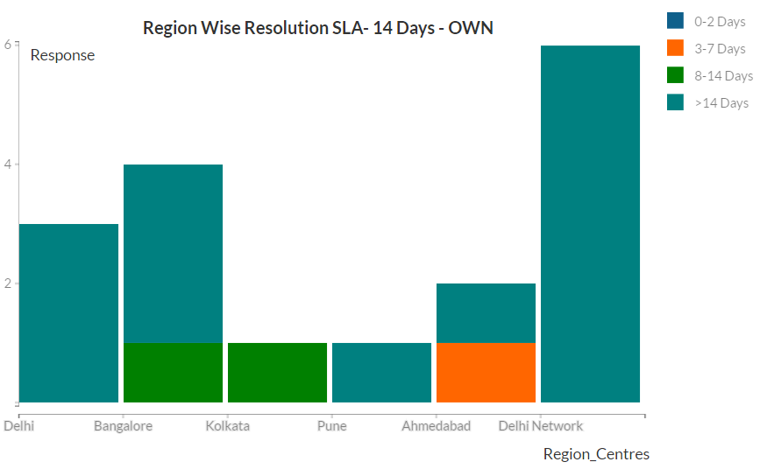
Region Wise Resolution SLA- 14 Days - OWN

Slide 13
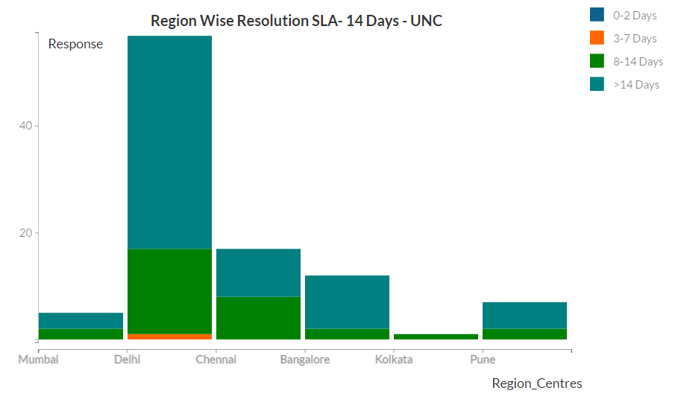
Region Wise Resolution SLA- 14 Days - UNC

Slide 14
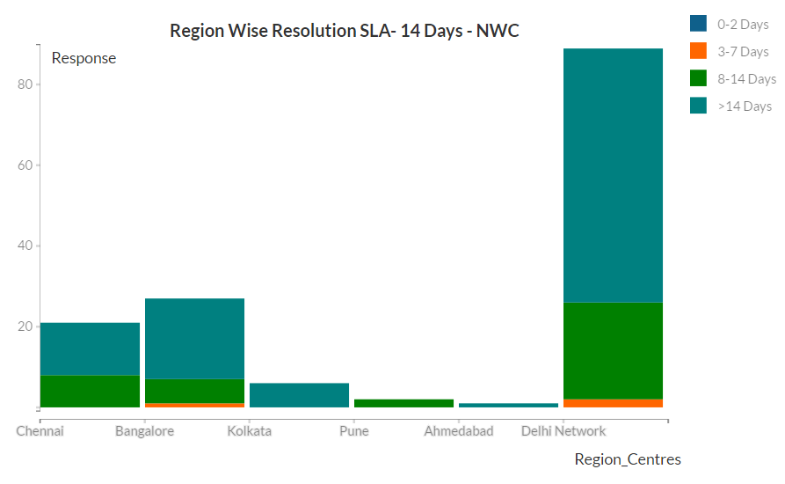
Region Wise Resolution SLA- 14 Days - NWC

Slide 15
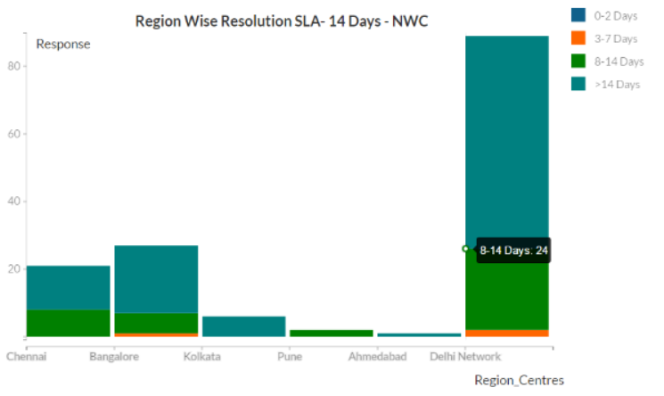
Tooltip
The Tooltip displays the category as well as the Total number of days.

Slide 16

Work in Progress. . .
Placing all the Stacked graph together in one container using TABS.
Horizontal Bar in Stacked Graph.
Placing ALL the graphs in one single page.
Using JSON file to extract data for Graphs.

